Slide 1
A2H 3D game for GPU and BL THERMAL status

Slide 2
Thermal test precondition
1. Disable 3D BL and GPU thermal policy
2. Enable CPU thermal policy
3. Manual setting 3D BL and GPU parameter
3. Running 60 minutes

Slide 3
3D game Power breakdown for 4V Disable thermal-engine
No. | 3D BL brightness | GPU Freq / MHz | Total power consumption / mA(4v) | Comments
1 | 0 | 515 | 795 | GPU + system
2 | 140 | 515 | 1194 | GPU + system + 3D BL/140
3 | 255 | 515 | 1550 | GPU + system + 3D BL/255
4 | 0 | 414 | 605 | GPU + system
5 | 140 | 414 | 1015 | GPU + system + 3D BL/140
6 | 255 | 414 | 1378 | GPU + system + 3D BL/255
7 | 0 | 342 | 521 | GPU + system
8 | 140 | 342 | 921 | GPU + system + 3D BL/140
9 | 255 | 342 | 1289 | GPU + system + 3D BL/255

Slide 4
3D gamePower breakdown for 3.8V Disable thermal-engine
No. | 3D BL brightness | GPU Freq / MHz | Total power consumption / mA(4v) | Comments
1 | 0 | 515 | 889 | GPU + system
2 | 140 | 515 | 1340 | GPU + system + 3D BL/140
3 | 255 | 515 | 1725 | GPU + system + 3D BL/255
4 | 0 | 414 | 728 | GPU + system
5 | 140 | 414 | 1146 | GPU + system + 3D BL/140
6 | 255 | 414 | 1525 | GPU + system + 3D BL/255
7 | 0 | 342 | 618 | GPU + system
8 | 140 | 342 | 1040 | GPU + system + 3D BL/140
9 | 255 | 342 | 1440 | GPU + system + 3D BL/255

Slide 5
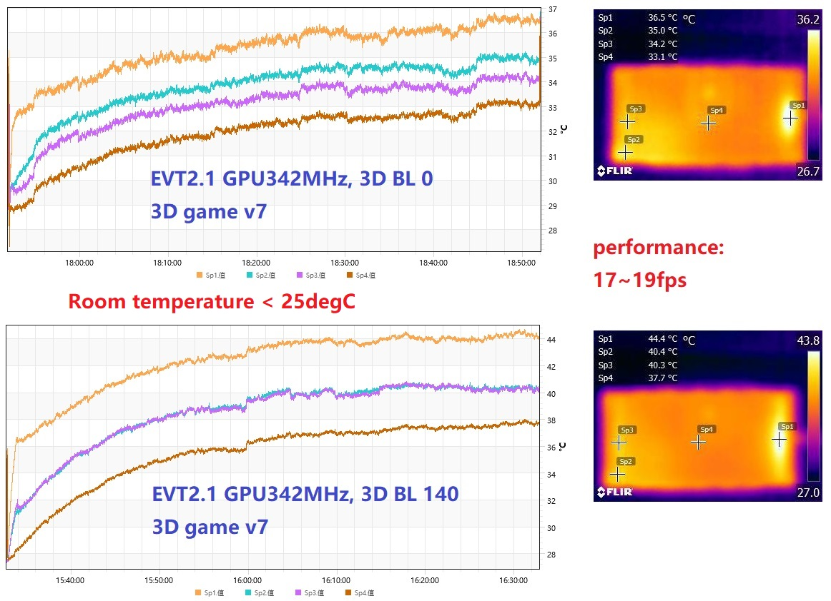
3D game, GPU 342MHz; < 25degC

Slide 6
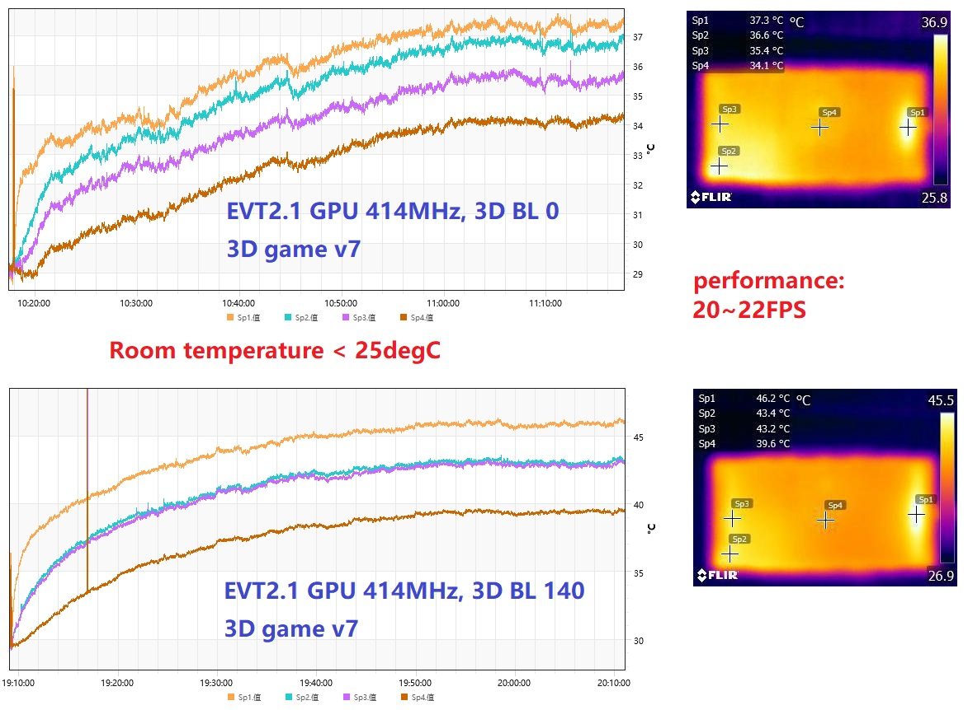
3D game, GPU 414MHz; < 25degC

Slide 7
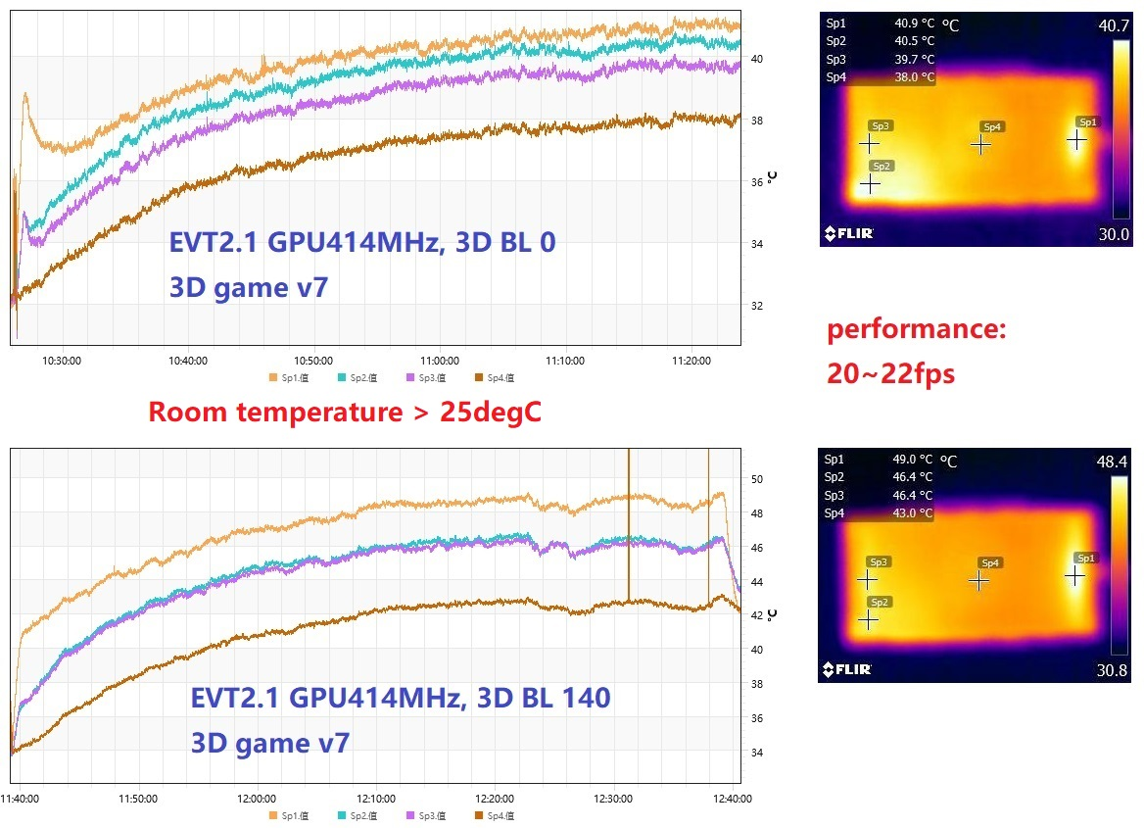
3D game, GPU 414MHz; > 25degC

